Slide 1

Ust-Kamenogorsk, 9 September 2016

Slide 2
Overview
Newton Fund: £735m in 8 years for 15 countries
Administered by BEIS
Delivery partners
Partner countries

Slide 3
Delivery partners
1. Academy of Medical Sciences
2. British Academy
3. British Council
4. Innovate UK
5. Met Office
6. Royal Academy of Engineering (RAEng)
7. Royal Society
8. Research Councils UK (RCUK):
- Arts and Humanities Research Council (AHRC)
- Biotechnology and Biosciences Research Council (BBSRC)
- Economic and Social Research Council (ESRC)
- Engineering and Physical Sciences Research Council (EPSRC)
- Medical Research Council (MRC)
- Natural Environment Research Council (NERC)
- Science & Technology Facilities Council (STFC)

Slide 4
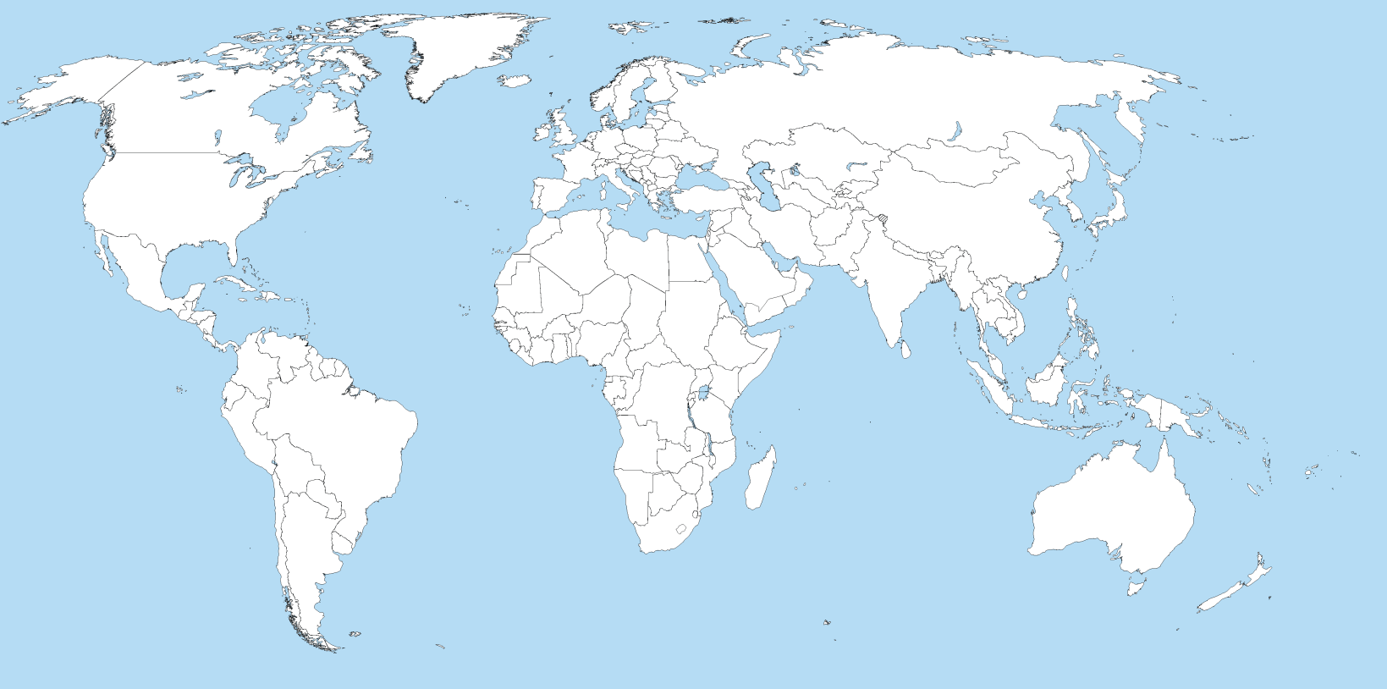
Partner countries
Egypt
Turkey
Kazakhstan
Mexico
China
Colombia
Philippines
Vietnam
Brazil
Thailand
Chile
Malaysia
Indonesia
South Africa
Kenya
India

Slide 5
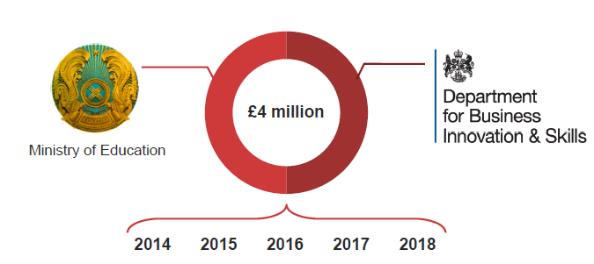
Newton – Al-Farabi Partnership Programme
Launched in 2014
Aims to promote Kazakhstan’s development by building links with the UK in the fields of science, research and innovation
Jointly funded by the UK Government and the Government of Kazakhstan, each giving up to £2m (c. KZT 900m) per year
Ministry of Education and Science

Slide 6
Goal and Priorities
The Newton – Al-Farabi Partnership Programme’s primary purpose is to promote the economic development and welfare of Kazakhstan.
The Programme has six priority areas for its activity:
  Energy
  Health and wellbeing
  Agricultural technologies
  Resilience and natural disasters
  Ecology and the environment
  Food and water
These should be understood as wide areas of focus rather than narrow technical categories.

Slide 7
How it works in Kazakhstan
Department for Business, Energy and Industrial Strategy
British Council
British Council
Royal Academy of Engineering
Other delivery partners

Slide 8
Activities
Calls run by the British Council:
A call for proposals for joint workshops. Workshops will be held in Kazakhstan and bring together Early Career Researchers from both countries to form new relationships and collaborations
A call for proposals for short term travel grants. These give funding for researchers from Kazakhstan to spend up to 6 months doing research in the UK, and vice versa
A call for proposals for 2-year post-doctoral mobility placements. These give funding for researchers from Kazakhstan to spend up to 2 years doing research in the UK
Funding to develop long-term institutional links between universities or research departments in the UK and Kazakhstan
Calls run by the Royal Academy of Engineering:
The Industry-Academia Partnership Programme aims to support Kazakh universities in improving their engineering education and research output through partnership with industry and UK stakeholders.

Slide 9
Researcher Links Workshops
Workshops that bring together up to 20 Early Career Researchers from the UK and up to 20 from Kazakhstan who work in similar fields
Workshops aim to facilitate new contacts and relationships that will lead to international collaborations and joint research publications
Proposals should be submitted jointly by two senior researchers (lead coordinators), one from the UK and one from Kazakhstan
Workshops can last between 3 and 5 days and should be held in Kazakhstan
The Newton – Al-Farabi Partnership Programme will cover the costs of holding the workshop (including travel for participants) up to a maximum of £44,200 (c. KZT 20m)

Slide 10
Researcher Links Travel Grants
Funding for Researchers from Kazakhstan to spend up to 6 months doing research in the UK, or for Researchers from the UK to visit Kazakhstan
Covers travel, subsistence, visas, insurance and research costs up to £13,240 (c. KZT 6m) for a 6-month visit
Researchers from Kazakhstan should identify a UK partner themselves
No fixed language requirements. But researchers from Kazakhstan will need good enough English to work with colleagues and do research in the UK
Applicants need either a doctoral degree (PhD or doctor nauk) or a masters / kandidat nauk plus equivalent research experience

Slide 11
Researcher Links Post-Doctoral Mobility
Funding for recent doctoral graduates from Kazakhstan to spend up to 2 years doing research in the UK
Covers travel, subsistence, visas, insurance and research costs up to £44,660 (c. KZT 20m) for a 2-year placement
The British Council can help applicants from Kazakhstan find a UK partner
No fixed language requirements. But researchers from Kazakhstan will need good enough English to work with colleagues and do research in the UK
Applicants need to have completed a doctoral degree (PhD or doctor nauk) within the last 5 years

Slide 12
Institutional Links
Funding for research partnerships between universities / departments / research groups in the UK and Kazakhstan
Can involve more than one partner in each country
Can involve private sector organisations and NGOs
Grants of up to £300,000 (c. KZT 135m) over 2 years
Grants can cover research costs, staff costs, researcher exchange, seminar and workshop costs

Slide 13
Industry-Academia partnership by RA Eng
Funding for collaborative activities among industry and academic partners in Kazakhstan and the UK
The lead applicant will be a Kazakh university which must propose a means of collaboration with at least one industry partner and one UK institution (academic or industry)
Grants in the range of £1,000 to £50,000 (KZT 450,000 – KZT 22m) for no more than 24 months
Grants can cover research costs, staff costs, researcher exchange, seminar and workshop costs

Slide 14
Other Activities
In addition to grants, we are offering
A Professional Development and Engagement Programme offering Kazakhstani researchers training and opportunities to engage with the end users of their research
A PhD Support Service to put Kazakhstani students who would like to study for a PhD or undertake post-doctoral research in the UK in touch with potential supervisors in the UK

Slide 15
Thank you!
newton-al-farabi@kz.britishcouncil.org
rowan.kennedy@kz.britishcouncil.org
www.newtonfund.ac.uk
www.britishcouncil.kz/newton-al-farabi
@NewtonFund

